Slide 1

Monitoring Apache Airflow
Notes:
https://courses.cs.washington.edu/courses/cse403/13au/lectures/git.ppt.pdf
http://enos.itcollege.ee/~jpoial/allalaadimised/git/getting-started-with-git.pdf

Slide 2
Monitoring Apache Airflow
How does the logging system work in Airflow?
Setting up custom logging
Storing logs in Azure
Elasticsearch Overview
Configuring Airflow with Elasticsearch
Monitoring your DAGs with Elasticsearch
Introduction to metrics
Monitoring Airflow with TIG stack
Triggering alerts for Airflow with Grafana
Airflow maintenance DAGs

Slide 3
How the logging system works in Airflow
The logger system

Slide 4
The basics
Based on the logging module
Written into files
Log levels (INFO, ERROR, DEBUG, WARNING, CRITICAL)
Formatters
Handlers for outputs
FileHandIer
StreamHandler
NulIHandler

Slide 5
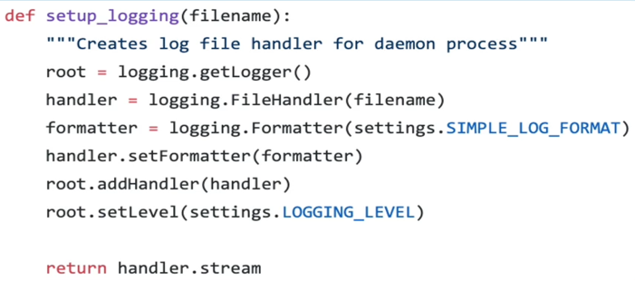
How the logger is set up
getLogger()
FileHandIer
Formatter
settings.SlMPLE_LOG_FORMAT
setFormatter
addHandIer
setLeveI
settings.LOGGlNG_LEVEL

Slide 6
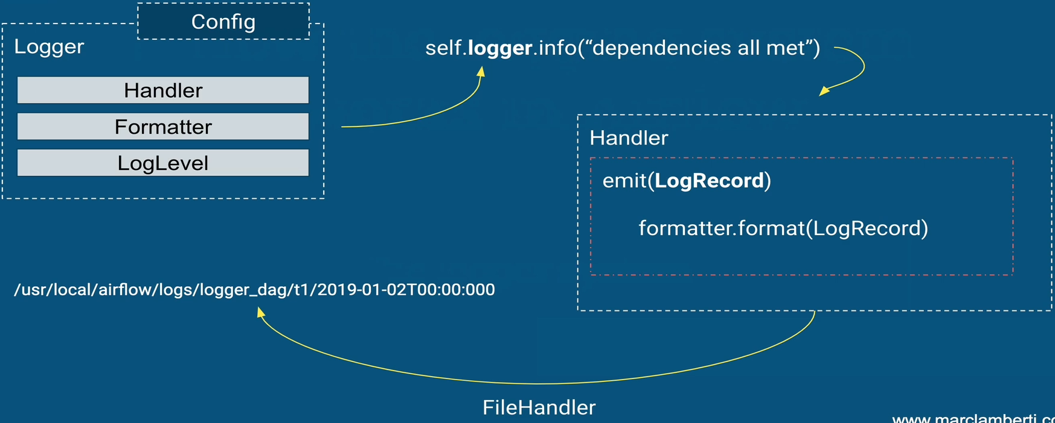
How the logging system works?

Slide 7
Where the logs are stored?
Depends on the handler
File
Stream
S3
ES
GCS
…

Slide 8
Elasticsearch Reminder

Slide 9

What is Elasticsearch?

Slide 10
How Elasticsearch works?
{
"_id": 2,
"Name": "my_log",
"Message": "it works",
"LogLevel": " INFO" ,
"Process": "ueryd_8990"
"_type": "log_sys"
}

Slide 11
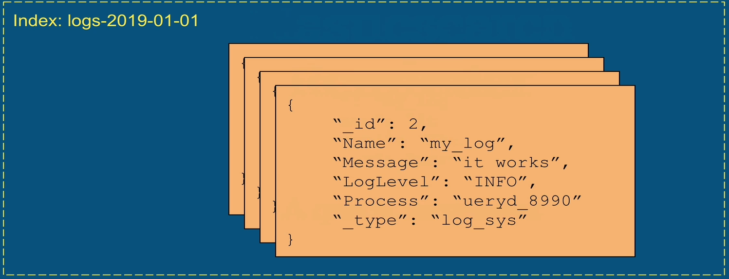
How Elasticsearch works?

Slide 12
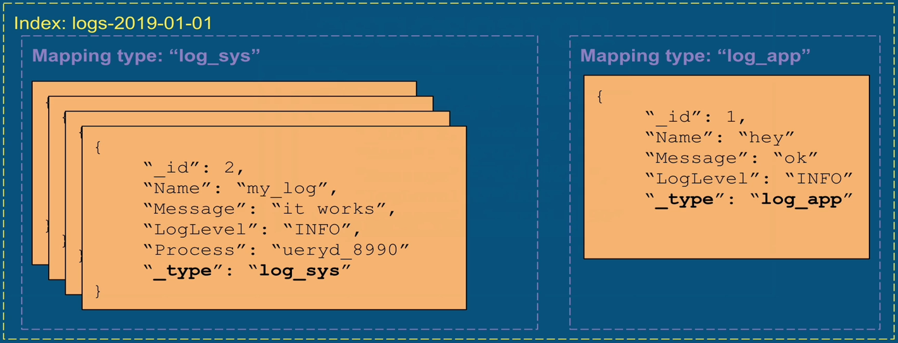
How Elasticsearch works?

Slide 13

ELK Stack

Slide 14
Configuring Airflow with Elasticsearch
Setting up the ELK architecture and Airflow

Slide 15

Architecture

Slide 16

Architecture

Slide 17
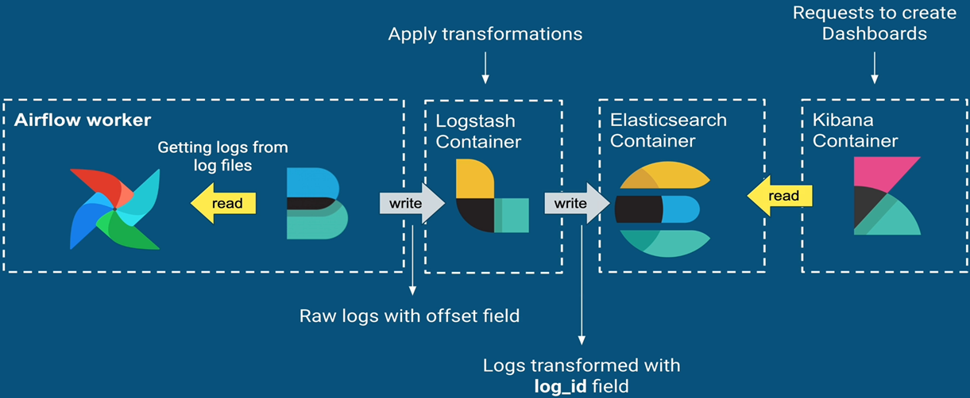
Architecture

Slide 18
Important points
Airflow assumes that each log message has the field offset
Number to read logs in the right order
Defined through Filebeat
Airflow assumes that each log message has the field log_id
{dag_id}-{task_id}—{execution_date}—{try_number}
Must be defined through Logstash

Slide 19
Introduction to metrics
Airflow and StatsD

Slide 20
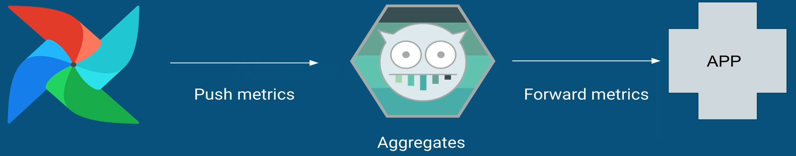
StatsD
Airflow sends metrics to StatsD
Daemon to aggregate and summarize application metrics
Extremely fast (UDP) and tiny resource footprint
Forward metrics to other applications

Slide 21
Metrics
All metrics based on three types
Counters
Gauges
Timers
Exhaustive lists
https://airfiow.apache.org/docs/stabIe/metrics.html

Slide 22

TIG Stack
Telegraf
Agent for collecting, processing, aggregating metrics
InfluxDB
Time series database
Grafana
Data visualization and monitoring application

Slide 23
Important points
StatsD package must be installed
Metrics can be filtered with statsd_allow_list

Slide 24
Airflow Maintenance DAGs

Slide 25
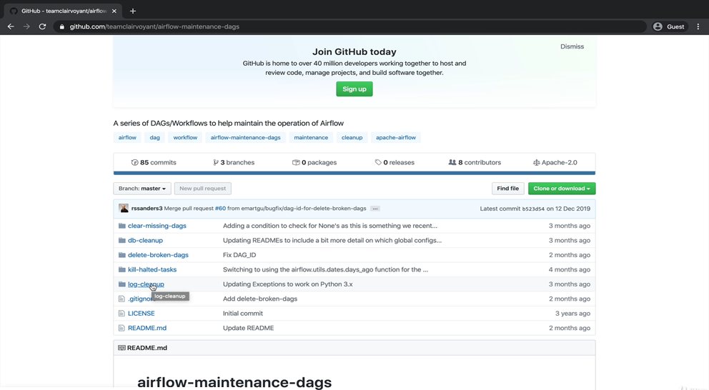
Airflow Maintenance DAGs

Slide 26
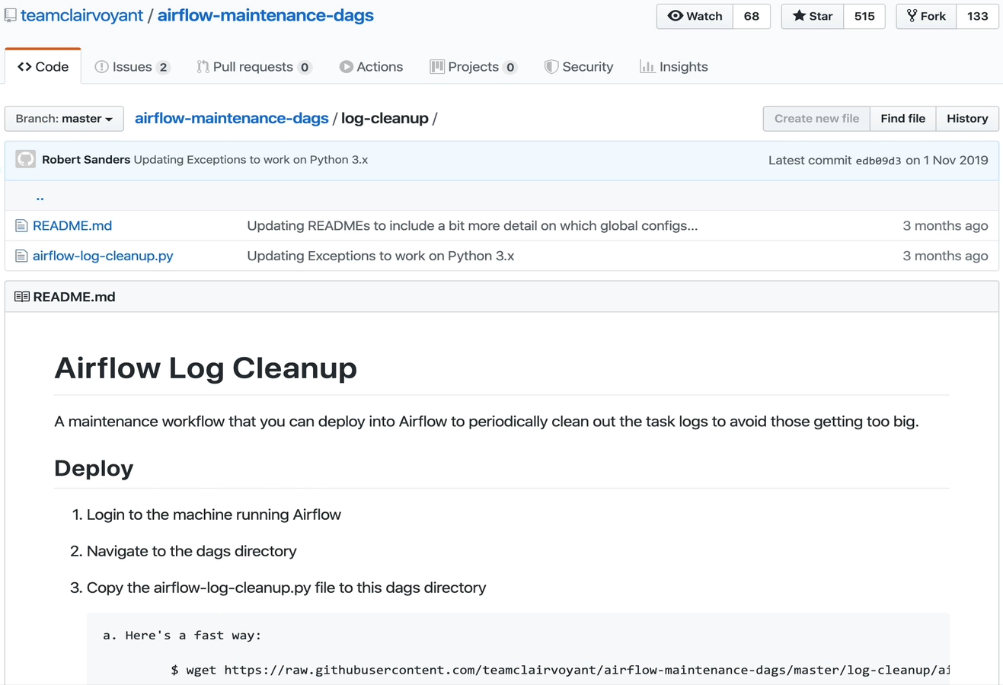
Airflow Log Cleanup

Slide 27
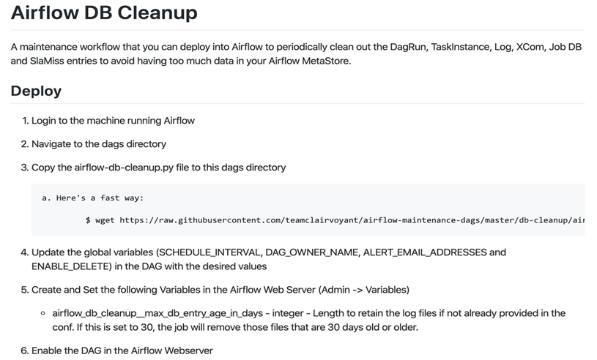
Airflow DB Cleanup

Slide 28
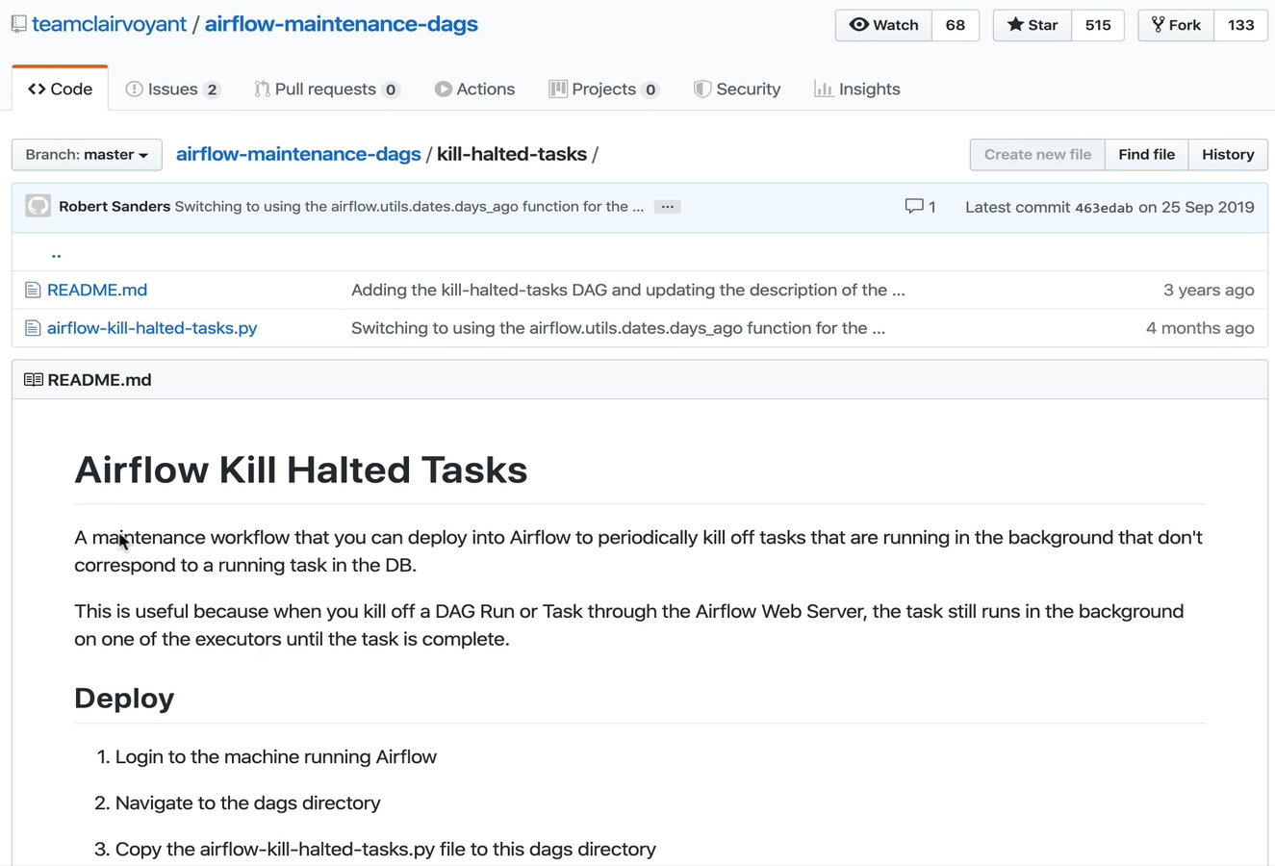
Airflow Kill Halted Tasks

Slide 29
Thanks

